Slide 1
Automating nopCommerce Demo using Cucumber BDD
Under Guidance of Mrs. Vaishali Sonawane Mam.
presented By:Vangapandu lakshman

Slide 2
Introduction :
nopCommerce is An open-source eCommerce platform.
Provides features like product catalog, shopping cart, checkout, customer accounts, etc.
Demo site: https://demo.nopcommerce.com.
Purpose of the project
To demonstrate test automation of nopCommerce using Cucumber BDD.
To show how feature files, step definitions, and test execution come together.

Slide 3
Members of Team
Vangapandu lakshman

Slide 4
Responsibilities
Understand nopCommerce demo site features (registration, login, search, cart, checkout).
Write test scenarios in Gherkin (Given–When–Then) format.
Create step definitions and connect them with Selenium WebDriver.
Run tests using Cucumber runner and check results.
Generate simple test reports.

Slide 5
Overview
NopCommerce is an open-source eCommerce platform with features like registration, login, product search, cart, and checkout.
The demo site (https://demo.nopcommerce.com) is used for testing and practice.
Cucumber BDD helps write test cases in plain English (Given–When–Then), making them easy to understand for both technical and non-technical users.
Using Cucumber + Selenium, we can automate nopCommerce workflows to ensure functionality works as expected.
The project demonstrates end-to-end test automation with feature files, step definitions, test execution, and reporting.

Slide 6
Modules
Module 1 : User Registration
Checked all the functionalities on registration page which included personal info.
Module 2 : login
Checked all the functionalities on login page which included personal info like email and password
Module 3 : product search
Verified search functionality by searching multiple items.
Notes:
Module 1: Signn in page
Checked all the functionalities on Sign in page which included personal info as email
address, password
Module 2: Women page
Checked all the functionalities on Women page which included item details, Quantity, Filters,compare button,Add to cart button,product info,grid,list button
Module 3: Tshirt page
Checked all the functionalities on T-Shirt page which included item details, Quantity, Filters,compare button,Add to cart button,product info,grid,list button
Module 4: All Buttons and Drop Down Arrow :
team checked if all the buttons and drop down arrows of different fields are functioning properly or not

Slide 7
Module 4 : Product Catalog
Verified by Browsing categories and product details.
Module 5 : Add to Cart
verified by Adding items to the shopping cart
Module 6 : Remove from Cart
verified by Deleting items from the cart.
Module 7 : Wishlist
verified by wishlisting items what we like .

Slide 8
Module 8 : Checkout (Guest / Registered User)
verified by placing the order
Module 9 : Community Poll
verified by Voting on polls in the store.
Module 10 : Newsletter Subscription
Verified by Viewing the newsletter and subscribe/unsubscribe
Notes:
Module 1: Signn in page
Checked all the functionalities on Sign in page which included personal info as email
address, password
Module 2: Women page
Checked all the functionalities on Women page which included item details, Quantity, Filters,compare button,Add to cart button,product info,grid,list button
Module 3: Tshirt page
Checked all the functionalities on T-Shirt page which included item details, Quantity, Filters,compare button,Add to cart button,product info,grid,list button
Module 4: All Buttons and Drop Down Arrow :
team checked if all the buttons and drop down arrows of different fields are functioning properly or not

Slide 9
Defects
While running a testcase at certain point some fields are not working as it is expected which is nothing but a defect, so my team have created a Defect report on those defects.

Slide 10
Defect identifier :- B_001
Defect summary :- Add to wishlist button is not working for certain products
Ø Test Id :- WISH-03
Ø Test case name :- Add Nikon D5500 DSLR to wishlist
Ø Module name :- Wishlist
Ø Reproducible :- yes
Ø Severity :- medium
Ø Priority :- high
Ø Raised by :- Tester- lakshman
Ø Assigned to :- developer
Ø Date of assignment :- 7-09-2025
Ø Status :- open
Ø Snap shots :-
Ø Fixed by :- developer
Ø Date of fixing :-

Slide 11
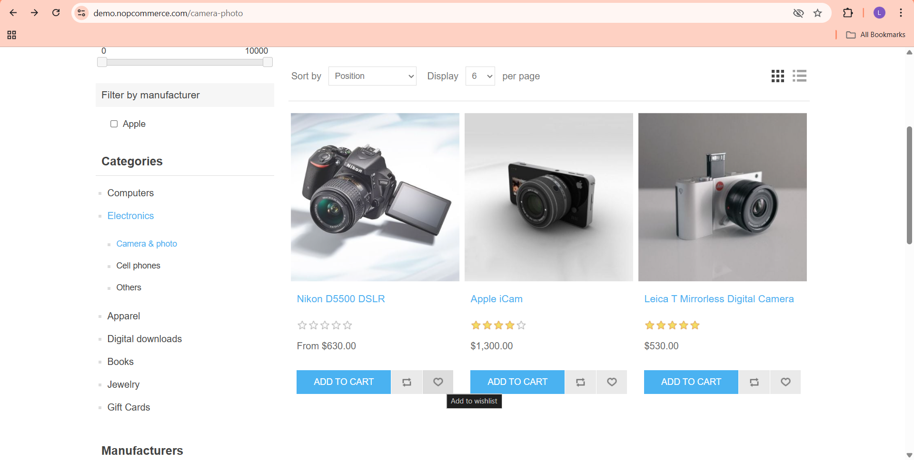

Slide 12
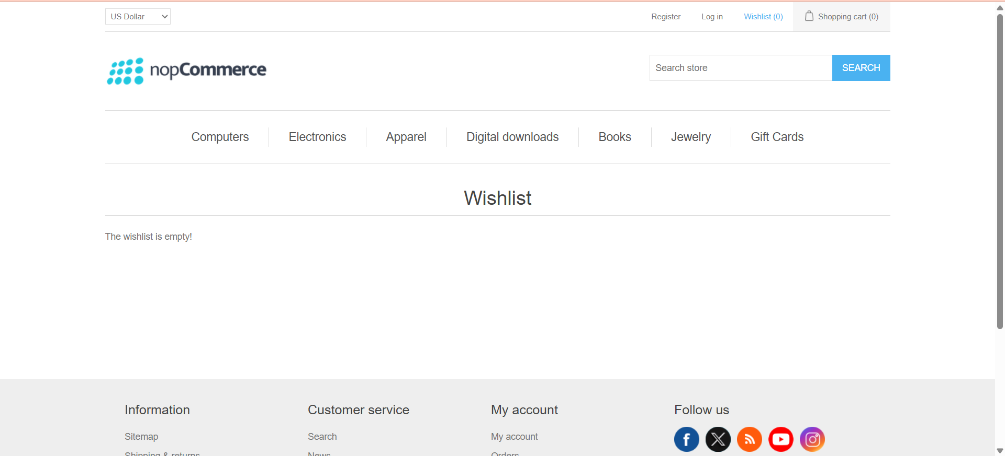

Slide 13
Defect identifier :- B_002
Ø Defect summary :- Password reset link not sent
Ø Test Id :- login-07
Ø Test case name :- Forgot Password
Ø Module name :- login
Ø Reproducible :- yes
Ø Severity :- high
Ø Priority :- high
Ø Raised by :- tester- lakshman
Ø Assigned to :- developer
Ø Date of assignment :-7-09-2025
Ø Status :- open
Ø Snap shots :-
Ø Fixed by :- developer
Ø Date of fixing :-

Slide 14
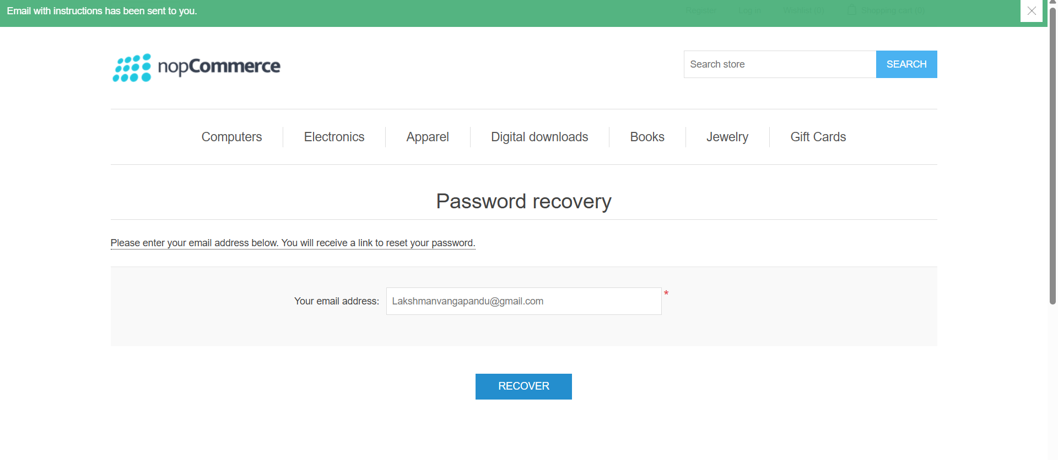
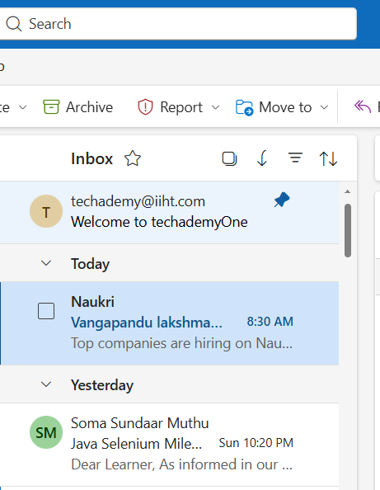

Slide 15
Challenges
While testing big website which contains huge data we faced some challenges about:
Matching Gherkin steps correctly with step definitions.
Handling dynamic elements and changing locators on the nopCommerce site.
Managing test data (e.g., unique emails for registration).
Synchronization issues like page load delays or slow responses.

Slide 16
Experience
Gained hands-on practice with Cucumber BDD framework.
Learned to write feature files in Gherkin (Given–When–Then).
Implemented step definitions using Selenium WebDriver.
Automated key nopCommerce modules like registration, login, search, cart, and checkout.
Experienced test execution and reporting using Cucumber runner.
Improved understanding of real-world eCommerce workflows.

Slide 17
Thank You!!!
Vaishali Mam For Guiding Us through out the Project.

